Slide 1
虛擬化技術
Virtualization Techniques
Network Virtualization
Software Defined Network

Slide 2
SOFTWARE DEFINED NETWORK
Introduction
Motivation
Concept
Open Flow
Virtual Switch

Slide 3
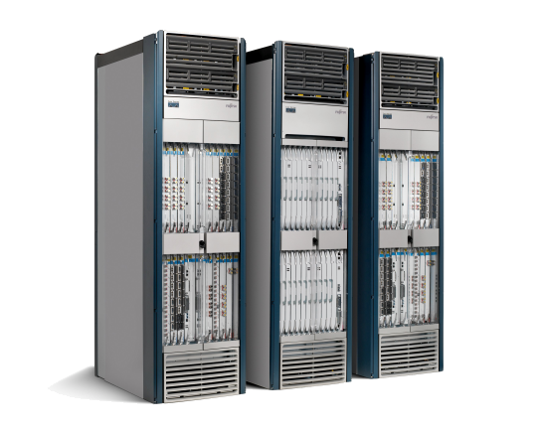





We have lost our way
Routing, management, mobility management,
access control, VPNs, …
App
App
App
Million of lines
of source code
5400 RFCs
Barrier to entry
Operating
System
Specialized Packet Forwarding Hardware
500M gates
10Gbytes RAM
Bloated
Power Hungry
Many complex functions baked into the infrastructure
    OSPF, BGP, multicast, differentiated services,
    Traffic Engineering, NAT, firewalls, MPLS, redundant layers, …
An industry with a “mainframe-mentality”

Slide 4








Reality
App
App
App
App
App
App
Operating
System
Operating System
Specialized Packet Forwarding Hardware
Specialized Packet Forwarding Hardware
Lack of competition means glacial innovation
Closed architecture means blurry, closed interfaces
Vertically integrated, complex, closed, proprietary
Not suitable for experimental ideas
Not good for network owners & users
Not good for researchers

Slide 5
Glacial process of innovation made worse by captive standards process
Deployment
Idea
Standardize
Wait 10 years
Driven by vendors
Consumers largely locked out
Lowest common denominator features
Glacial innovation

Slide 6
SOFTWARE DEFINED NETWORK
Introduction
Motivation
Concept
Open Flow
Virtual Switch

Slide 7

























Trend
App
App
App
App
App
App
Controller 1
Controller
2
Windows
(OS)
Linux
Mac
OS
Controller 1
Controller
2
Windows
(OS)
Linux
Mac
OS
NOX
(Network OS)
Network OS
Windows
(OS)
Linux
Mac
OS
Virtualization layer
Virtualization or “Slicing”
x86
(Computer)
OpenFlow
Computer Industry
Network Industry

Slide 8




























The “Software-defined Network”
App
App
App
Network Operating System
App
App
App
Operating
System
Specialized Packet Forwarding Hardware
App
App
App
Operating
System
App
App
App
Specialized Packet Forwarding Hardware
Operating
System
App
App
App
Specialized Packet Forwarding Hardware
Operating
System
Specialized Packet Forwarding Hardware
App
App
App
Operating
System
Specialized Packet Forwarding Hardware

Slide 9




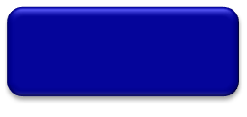
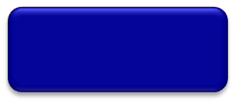

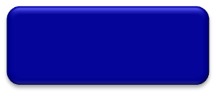
The “Software-defined Network”
2. At least one good operating system
Extensible, possibly open-source
3. Well-defined open API
App
App
App
Network Operating System
1. Open interface to hardware
Simple Packet Forwarding Hardware
Simple Packet Forwarding Hardware
Simple Packet Forwarding Hardware
Simple Packet Forwarding Hardware
Simple Packet Forwarding Hardware

Slide 10


















Isolated “slices”
Many operating systems, or
Many versions
App
App
App
App
App
App
App
App
Network Operating System 1
Network Operating System 2
Network Operating System 3
Network Operating System 4
Open interface to hardware
Virtualization or “Slicing” Layer
Open interface to hardware
Simple Packet
Forwarding Hardware
Simple Packet
Forwarding Hardware
Simple Packet
Forwarding Hardware
Simple Packet
Forwarding Hardware
Simple Packet
Forwarding Hardware

Slide 11
Consequences
More innovation in network services
  Owners, operators, 3rd party developers, researchers can improve the network
  E.g. energy management, data center management, policy routing, access control, denial of service, mobility
Lower barrier to entry for competition
  Healthier market place, new players

Slide 12
SOFTWARE DEFINED NETWORK
Introduction
Motivation
Concept
Open Flow
Virtual Switch

Slide 13


Traditional network node: Router
Router can be partitioned into control and data plane
  Management plane/ configuration
  Control plane / Decision: OSPF (Open Shortest Path First)
  Data plane / Forwarding
Adjacent Router
Router
Adjacent Router
Management/Policy plane
Configuration / CLI / GUI
Routing
Control plane
Control plane
Static routes
Control plane
OSPF
OSPF
OSPF
Neighbor table
Link state database
IP routing table
Switching
Data plane
Data plane
Data plane
Forwarding table

Slide 14
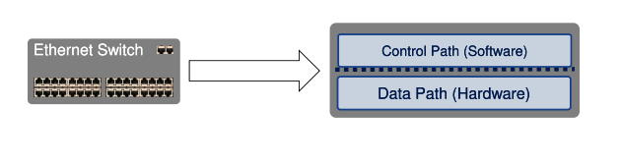
Traditional network node: Switch
Typical Networking Software
  Management plane
  Control Plane – The brain/decision maker
  Data Plane – Packet forwarder

Slide 15
SDN Concept
Separate Control plane and Data plane entities
  Network intelligence and state are logically centralized
  The underlying network infrastructure is abstracted from the applications
Execute or run Control plane software on general purpose hardware
  Decouple from specific networking hardware
  Use commodity servers
Have programmable data planes
  Maintain, control and program data plane state from a central entity
An architecture to control not just a networking device but an entire network

Slide 16
Control Program
Control program operates on view of network
  Input: global network view (graph/database)
  Output: configuration of each network device
Control program is not a distributed system
  Abstraction hides details of distributed state

Slide 17




Software-Defined Network with key Abstractions in the Control Plane
Network
Virtualization
Well-defined API
Routing
Traffic Engineering
Other Applications
Network Map
Abstraction
Network Operating System
Forwarding
Separation of Data
and Control Plane
Forwarding
Forwarding
Forwarding

Slide 18
Forwarding Abstraction
Purpose: Abstract away forwarding hardware
Flexible
  Behavior specified by control plane
  Built from basic set of forwarding primitives
Minimal
  Streamlined for speed and low-power
  Control program not vendor-specific
OpenFlow is an example of such an abstraction

Slide 19



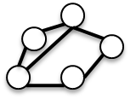
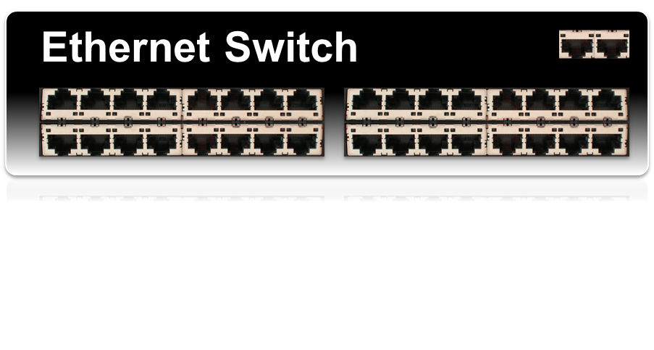
OpenFlow Basics
Control Program A
Control Program B
Network OS
OpenFlow Protocol
Control Path
OpenFlow
Data Path (Hardware)

Slide 20




OpenFlow Basics
Control Program A
Control Program B
Network OS
“If header = p, send to port 4”
Packet
Forwarding
“If header = q, overwrite header with r,
add header s, and send to ports 5,6”
“If header = ?, send to me”
Flow
Table(s)
Packet
Forwarding
Packet
Forwarding

Slide 21
Plumbing Primitives
<Match, Action>
Match arbitrary bits in headers:
  Match on any header, or new header
  Allows any flow granularity
Action
  Forward to port(s), drop, send to controller
  Overwrite header with mask, push or pop
  Forward at specific bit-rate
Header
Data
Match: 1000x01xx0101001x

Slide 22
General Forwarding Abstraction
Small set of primitives
“Forwarding instruction set”
Protocol independent
Backward compatible
Switches, routers, WiFi APs, basestations, TDM/WDM

Slide 23
SOFTWARE DEFINED NETWORK
Introduction
Motivation
Concept
Open Flow
Virtual Switch

Slide 24
What is OpenFlow
OpenFlow is similar to an x86 instruction set for the network
Provide open interface to “black box” networking node
  (ie. Routers, L2/L3 switch) to enable visibility and openness in network
Separation of control plane and data plane.
  The datapath of an OpenFlow Switch consists of a Flow Table, and an action associated with each flow entry
  The control path consists of a controller which programs the flow entry in the flow table
OpenFlow is based on an Ethernet switch, with an internal flow-table, and a standardized interface to add and remove flow entries

Slide 25
OpenFlow Consortium
http://OpenFlowSwitch.org
Goal
  Evangelize OpenFlow to vendors
  Free membership for all researchers
  Whitepaper, OpenFlow Switch Specification, Reference Designs
  Licensing: Free for research and commercial use

Slide 26
OpenFlow building blocks
oftrace
oflops
openseer
Monitoring/
debugging tools
Stanford Provided
ENVI (GUI)
LAVI
n-Casting
Expedient
Applications
NOX
Beacon
Trema
Maestro
ONIX
Controller
Slicing
Software
FlowVisor
Console
FlowVisor
Commercial Switches
Stanford Provided
Software
Ref. Switch
NetFPGA
Broadcom
Ref. Switch
HP, NEC, Pronto, Juniper.. and many more
OpenFlow
Switches
OpenWRT
PCEngine
WiFi AP
Open vSwitch
Notes:
There are components at different levels that work together in making it work
The commercial switch details will follow in next slide
There are a plethora of applications possible. I only list those available at Stanford

Slide 27
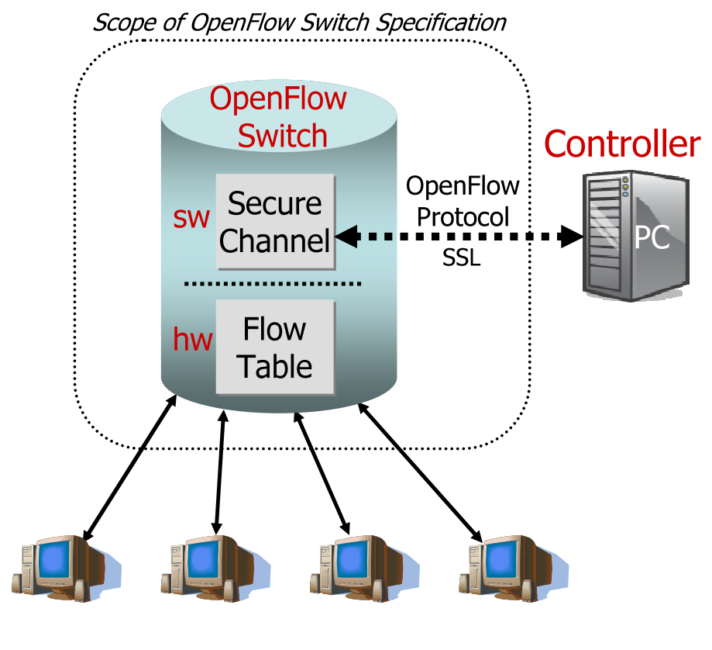
Components of OpenFlow Network
Controller
  OpenFlow protocol messages
  Controlled channel
  Processing
    Pipeline Processing
    Packet Matching
    Instructions & Action Set
OpenFlow switch
  Secure Channel (SC)
  Flow Table
    Flow entry

Slide 28
OpenFlow Controllers
Name | Lang | Platform(s) | License | Original Author | Notes
OpenFlow Reference | C | Linux | OpenFlow License | Stanford/Nicira | not designed for extensibility
NOX | Python, C++ | Linux | GPL | Nicira | actively developed
Beacon | Java | Win, Mac, Linux, Android | GPL (core), FOSS Licenses for your code | David Erickson (Stanford) | runtime modular, web UI framework, regression test framework
Maestro | Java | Win, Mac, Linux | LGPL | Zheng Cai (Rice)
Trema | Ruby, C | Linux | GPL | NEC | includes emulator, regression test framework
RouteFlow | ? | Linux | Apache | CPqD (Brazil) | virtual IP routing as a service
Notes:
Language open-source Performance cross-platform runtime modular

Slide 29
Secure Channel (SC)
SC is the interface that connects each OpenFlow switch to controller
A controller configures and manages the switch via this interface.
  Receives events from the switch
  Send packets out the switch
SC establishes and terminates the connection between OpneFlow Switch and the controller using the procedures
  Connection Setup
  Connection Interrupt
The SC connection is a TLS connection. Switch and controller mutually authenticate by exchanging certificates signed by a site-specific private key.

Slide 30
Flow Table
Flow table in switches, routers, and chipsets
Flow 1.
Rule
(exact & wildcard)
Action
Statistics
Flow 2.
Rule
(exact & wildcard)
Action
Statistics
Flow 3.
Rule
(exact & wildcard)
Action
Statistics
Rule
(exact & wildcard)
Flow N.
Default Action
Statistics

Slide 31











Flow Entry
A flow entry consists of
  Match fields
    Match against packets
  Action
    Modify the action set or pipeline processing
  Stats
    Update the matching packets
Match Fields
Action
Stats
In Port
Src MAC
Dst MAC
Eth Type
Vlan Id
IP Tos
IP Proto
IP Src
IP Dst
TCP Src Port
TCP Dst Port
Layer 2
Layer 3
Layer 4
Forward packet to port(s)
Encapsulate and forward to controller
Drop packet
Send to normal processing pipeline
1. Packet
2. Byte counters

Slide 32
Examples
Switching
Switch
Port
MAC
src
MAC
dst
Eth
type
VLAN
ID
IP
Src
IP
Dst
IP
Prot
TCP
sport
TCP
dport
Action
*
*
00:1f:..
*
*
*
*
*
*
*
port6
Flow Switching
Switch
Port
MAC
src
MAC
dst
Eth
type
VLAN
ID
IP
Src
IP
Dst
IP
Prot
TCP
sport
TCP
dport
Action
port3
00:20..
00:1f..
0800
vlan1
1.2.3.4
5.6.7.8
4
17264
80
port6
Firewall
Switch
Port
MAC
src
MAC
dst
Eth
type
VLAN
ID
IP
Src
IP
Dst
IP
Prot
TCP
sport
TCP
dport
Action
*
*
*
*
*
*
*
*
*
22
drop

Slide 33
Examples
Routing
Switch
Port
MAC
src
MAC
dst
Eth
type
VLAN
ID
IP
Src
IP
Dst
IP
Prot
TCP
sport
TCP
dport
Action
*
*
*
*
*
*
5.6.7.8
*
*
*
port6
VLAN Switching
Switch
Port
MAC
src
MAC
dst
Eth
type
VLAN
ID
IP
Src
IP
Dst
IP
Prot
TCP
sport
TCP
dport
Action
port6,
port7,
port9
*
*
00:1f..
*
vlan1
*
*
*
*
*

Slide 34


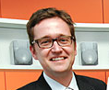


OpenFlow Usage
Controller
Peter’s code
OpenFlow
Switch
PC
Rule
Action
Statistics
OpenFlow
Protocol
OpenFlow
Switch
OpenFlow
Switch
Rule
Action
Statistics
Rule
Action
Statistics
OpenFlowSwitch.org
Peter

Slide 35
Usage examples
Peter’s code:
  Static “VLANs”
  His own new routing protocol: unicast, multicast, multipath, load-balancing
  Network access control
  Home network manager
  Mobility manager
  Energy manager
  Packet processor (in controller)
  IPvPeter
  Network measurement and visualization
  …

Slide 36

Separate VLANs for Production and Research Traffic
Controller
Research VLANs
Flow Table
Production VLANs
Normal L2/L3 Processing

Slide 37
Dynamic Flow Aggregation on an OpenFlow Network
Scope
  Different Networks want different flow granularity (ISP, Backbone,…)
  Switch resources are limited (flow entries, memory)
  Network management is hard
  Current Solutions : MPLS, IP aggregation

Slide 38
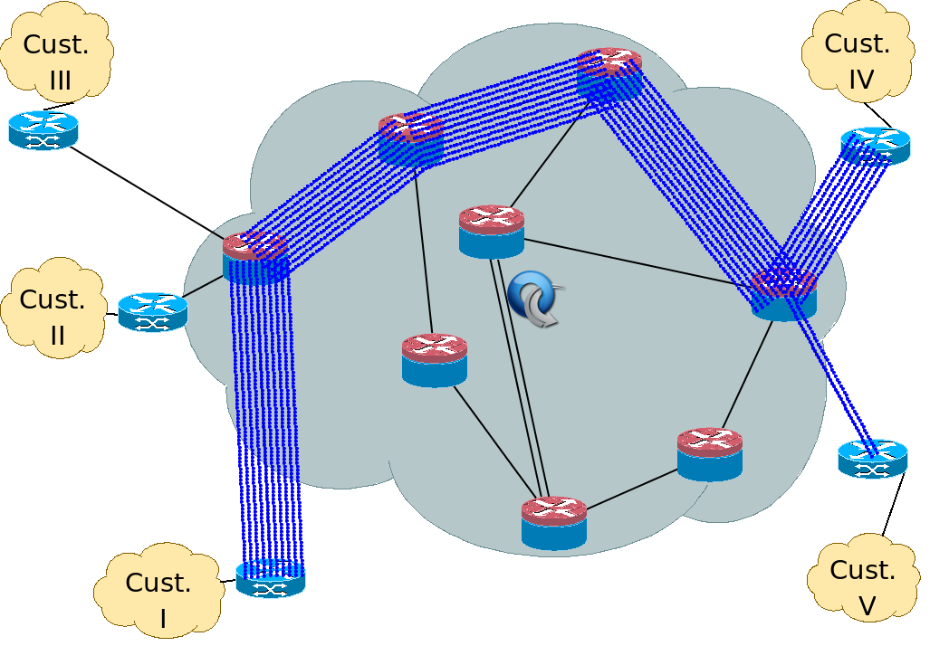
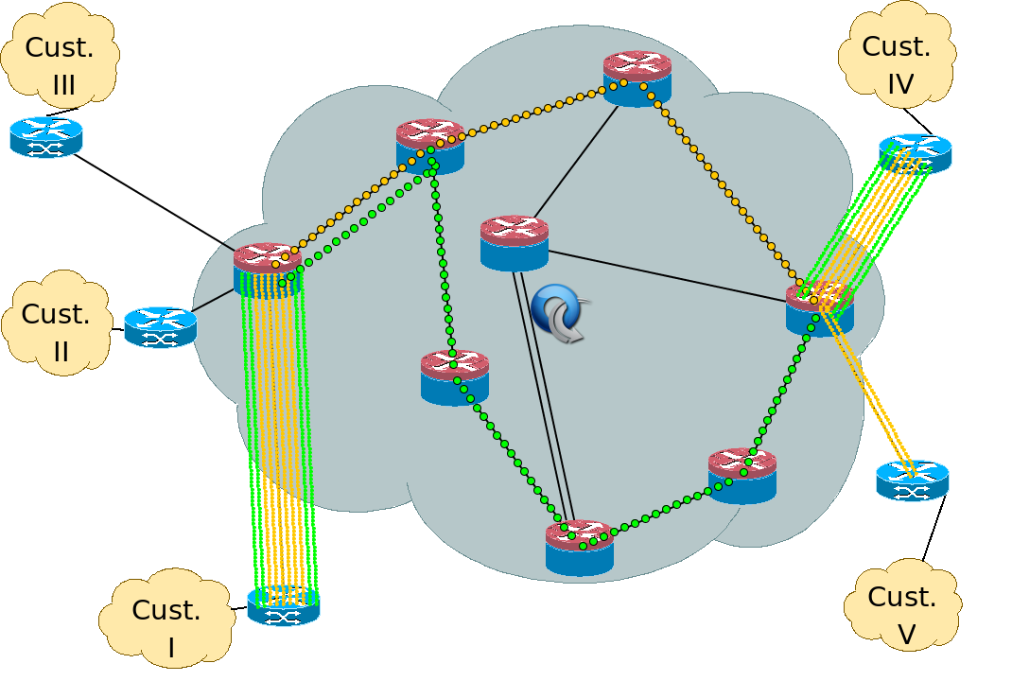
Dynamic Flow Aggregation on an OpenFlow Network
How do OpenFlow Help?
  Dynamically define flow granularity by wildcarding arbitrary header fields
  Granularity is on the switch flow entries, no packet rewrite or encapsulation
  Create meaningful bundles and manage them using your own software (reroute, monitor)

Slide 39
Virtualizing OpenFlow
Network operators “Delegate” control of subsets of network hardware and/or traffic to other network operators or users
Multiple controllers can talk to the same set of switches
Imagine a hypervisor for network equipments
Allow experiments to be run on the network in isolation of each other and production traffic

Slide 40

Switch Based Virtualization
Exists for NEC, HP switches but not flexible enough
Research VLAN 2
Flow Table
Controller
Research VLAN 1
Flow Table
Controller
Production VLANs
Normal L2/L3 Processing
Notes:
Experiments running on PRODUCTION infrastructure
Key to get scale, key to get traffic on the network
(e.g. can’t just do a reset...)

Slide 41
FlowVisor
A network hypervisor developed by Stanford
A software proxy between the forwarding and control planes of network devices

Slide 42


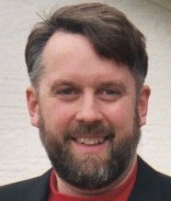

FlowVisor-based Virtualization
Heidi’s
Controller
Craig’s
Controller
Aaron’s
Controller
Topology discovery is per slice
OpenFlow
Protocol
OpenFlow
Switch
OpenFlow FlowVisor
& Policy Control
OpenFlow
Protocol
OpenFlow
Switch
OpenFlow
Switch

Slide 43
FlowVisor-based Virtualization
http
Load-balancer
Broadcast
Multicast
Separation not only
by VLANs, but any
L1-L4 pattern
dl_dst=FFFFFFFFFFFF
OpenFlow
Protocol
tp_src=80, or
tp_dst=80
OpenFlow
Switch
OpenFlow
FlowVisor & Policy Control
OpenFlow
Protocol
OpenFlow
Switch
OpenFlow
Switch

Slide 44
FlowVisor Slicing
Slices are defined using a slice definition policy
  The policy language specifies the slice’s resource limits, flowspace, and controller’s location in terms of IP and TCP port-pair
  FlowVisor enforces transparency and isolation between slices by inspecting, rewriting, and policing OpenFlow messages as they pass

Slide 45
FlowVisor Resource Limits
FV assigns hardware resources to “Slices”
  Topology
    Network Device or Openflow Instance (DPID)
    Physical Ports
  Bandwidth
    Each slice can be assigned a per port queue with a fraction of the total bandwidth
  CPU
    Employs Course Rate Limiting techniques to keep new flow events from one slice from overrunning the CPU
  Forwarding Tables
    Each slice has a finite quota of forwarding rules per device

Slide 46
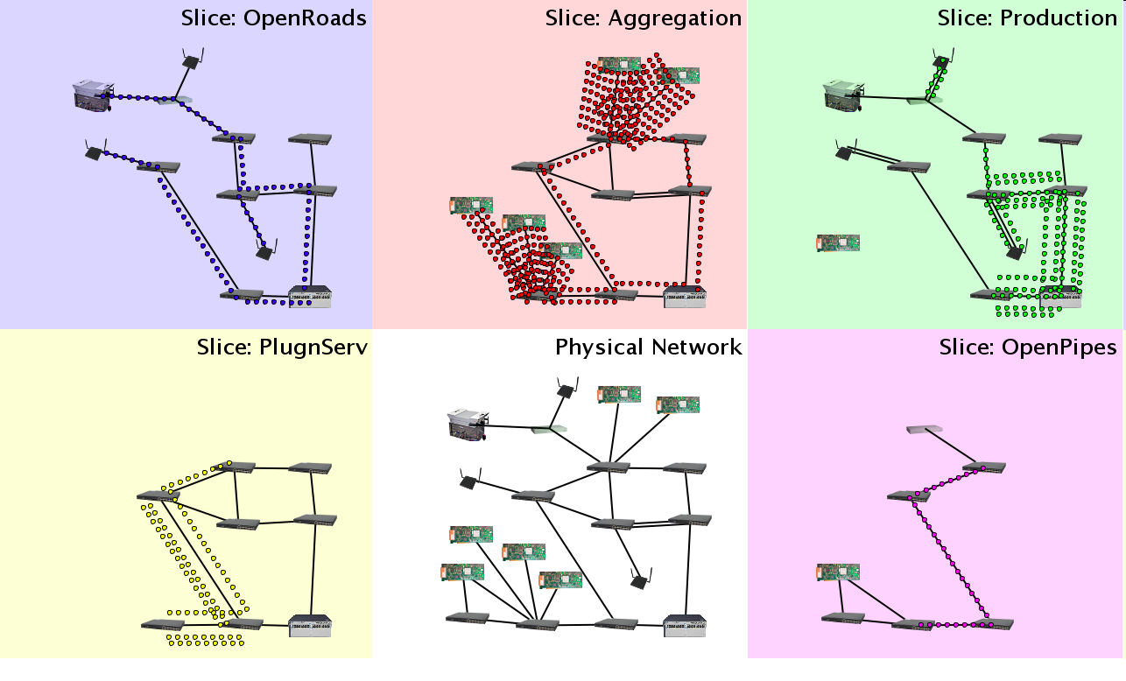
Slicing
Notes:
Carves Network into “Slices” and Assigns hardware resources to each slice. Switch DPID, Port.

Slide 47
FlowVisor FlowSpace
FlowSpace is defined by a collection of packet headers and assigned to “Slices”
  Source/Destination MAC address
  VLAN ID
  Ethertype
  IP protocol
  Source/Destination IP address
  ToS/DSCP
  Source/Destination port number

Slide 48
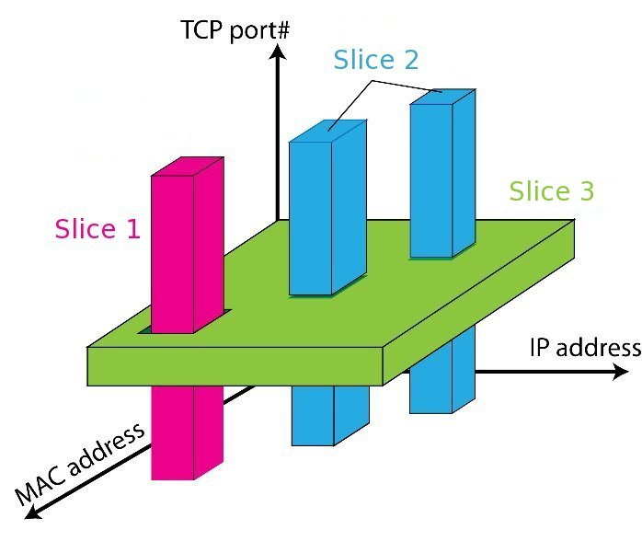
FlowSpace: Maps Packets to Slices

Slide 49
FlowVisor Slicing Policy
FV intercepts OF messages from devices
  FV only sends control plane messages to the Slice controller if the source device is in the Slice topology.
  Rewrites OF feature negotiation messages so the slice controller only sees the ports in it’s slice
  Port up/down messages are pruned and only forwarded to affected slices

Slide 50
FlowVisor Slicing Policy
FV intercepts OF messages from controllers
  Rewrites flow insertion, deletion & modification rules so they don’t violate the slice definition
    Flow definition – ex. Limit Control to HTTP traffic only
    Actions – ex. Limit forwarding to only ports in the slice
  Expand Flow rules into multiple rules to fit policy
    Flow definition – ex. If there is a policy for John’s HTTP traffic and another for Uwe’s HTTP traffic, FV would expand a single rule intended to control all HTTP traffic into 2 rules.
    Actions – ex. Rule action is send out all ports. FV will create one rule for each port in the slice.
  Returns “action is invalid” error if trying to control a port outside of the slice

Slide 51
FlowVisor Message Handling
Alice
Controller
Bob
Controller
Cathy
Controller
Rule
OpenFlow
Policy Check:
Is this rule allowed?
Policy Check:
Who controls this packet?
FlowVisor
OpenFlow
Full Line Rate
Forwarding
OpenFlow
Firmware
Exception
Packet
Data Path
Packet

Slide 52
SOFTWARE DEFINED NETWORK
Introduction
Motivation
Concept
Open Flow
Virtual Switch

Slide 53
INTRODUCTION
Due to the cloud computing service, the number of virtual switches begins to expand dramatically
  Management complexity, security issues and even performance degradation
Software/hardware based virtual switches as well as integration of open-source hypervisor with virtual switch technology is exhibited

Slide 54
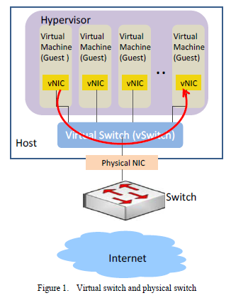
Software-Based Virtual Switch
The hypervisors implement vSwitch
Each VM has at least one virtual network interface cards (vNICs) and shared physical network interface cards (pNICs) on the physical host through vSwitch
Administrators don’t have effective solution to separate packets from different VM users
For VMs reside in the same physical machine, their traffic visibility is a big issue

Slide 55
Issues of Traditional vSwitch
The traditional vSwitches lack of advanced networking features such as VLAN, port mirror, port channel, etc.
Some hypervisor vSwitch vendors provide technologies to fix the above problems
  OpenvSwitch may be superior in quality for the reasons

Slide 56
Open vSwitch
A software-based solution
  Resolve the problems of network separation and traffic visibility, so the cloud users can be assigned VMs with elastic and secure network configurations
Flexible Controller in User-Space
Fast Datapath in Kernel
Server
Open vSwitch Controller
Open vSwitch Datapath

Slide 57
Open vSwitch Concepts
Multiple ports to physical switches
  A port may have one or more interfaces
    Bonding allows more than once interface per port
Packets are forwarded by flow
Visibility
  NetFlow
  sFlow
  Mirroring (SPAN/RSPAN/ERSPAN)
IEEE 802.1Q Support
  Enable virtual LAN function
  By attaching VLAN ID to Linux virtual interfaces, each user will have its own LAN environment separated from other users

Slide 58
Open vSwitch Concepts
Fine-grained ACLs and QoS policies
  L2-­‐L4 matching
  Actions to forward, drop, modify, and queue
  HTB and HFSC queuing disciplines
Centralized control through OpenFlow
Works on Linux-based hypervisors:
  Xen
  XenServer
  KVM
  VirtualBox

Slide 59
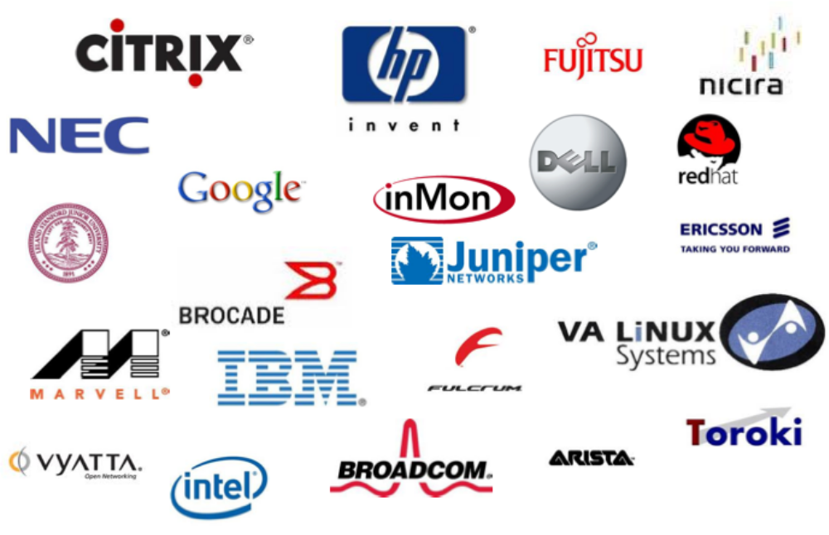
Open vSwitch Contributors(Partial)

Slide 60
Packets are Managed as Flows
A flow may be identied by any combination of
  Input port
  VLAN ID (802.1Q)
  Ethernet Source MAC address
  Ethernet Destination MAC address
  IP Source MAC address
  IP Destination MAC address
  TCP/UDP/... Source Port
  TCP/UDP/... Destination Port

Slide 61
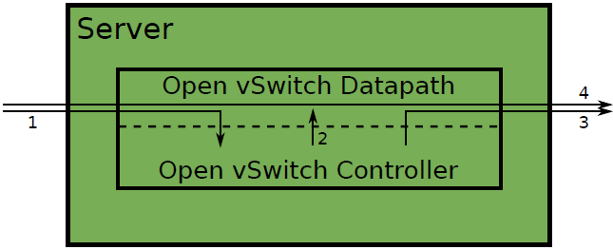
Packets are Managed as Flows
The 1st packet of a flow is sent to the controller
The controller programs the datapath's actions for a flow
  Usually one, but may be a list
  Actions include:
    Forward to a port or ports
    mirror
    Encapsulate and forward to controller
    Drop
And returns the packet to the datapath
Subsequent packets are handled directly by the datapath

Slide 62
Migration
KVM and Xen provide Live Migration
With bridging, IP address migration must occur with in the same L2 network
Open vSwitch avoids this problem using GRE tunnels

Slide 63
Hardware-Based Virtual Switch
Why hardware-based?
  Software virtual switches consume CPU and memory usage
  Possible inconsistence of network and server configurations may cause errors and is very hard to troubleshooting and maintenance
Hardware-based virtual switch solution emerges for better resource utilization and configuration consistency

Slide 64
Virtual Ethernet Port Aggregator
A standard led by HP, Extreme, IBM, Brocade, Juniper, etc.
An emerging technology as part of IEEE 802.1Qbg Edge Virtual Bridge (EVB) standard
The main goal of VEPA is to allow traffic of VMs to exit and re-enter the same server physical port to enable switching among VMs

Slide 65
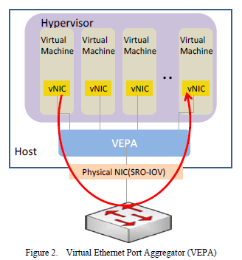
Virtual Ethernet Port Aggregator
VEPA software update is required for host servers in order to force packets to be transmitted to external switches
An external VEPA enabled switch is required for communications between VMs in the same server
VEPA supports “hairpin” mode which allows traffic to “hairpin” back out the same port it just received it from--- requires firmware update to existing switches

Slide 66
Pros. and Cons. for VEPA
Pros
  Minor software/firmware update, network configuration maintained by external switches
Cons
  VEPA still consumes server resources in order to perform forwarding table lookup

Slide 67
References
"OpenFlow: Enabling Innovation in Campus Networks“ N. McKeown, T. Andershnan, G. Parulkar, L. Peterson, J. Rexford, S. Shenker, and J. Turneron, H. Balakris ACM Computer Communication Review, Vol. 38, Issue 2, pp. 69-74 April 2008
OpenFlow Switch Specication V 1.1.0.
Richard Wang, Dana Butnariu, and Jennifer Rexford OpenFlow-based server load balancing gone wild, Workshop on Hot Topics in Management of Internet, Cloud, and Enterprise 66 IP Infusion Proprietary and Confidential, released under Customer NDA , Roadmap items subject to change without notice © 2011 IP Infusion Inc. gone wild, Workshop on Hot Topics in Management of Internet, Cloud, and Enterprise Networks and Services (Hot-ICE), Boston, MA, March 2011.
Saurav Das, Guru Parulkar, Preeti Singh, Daniel Getachew, Lyndon Ong, Nick McKeown, Packet and Circuit Network Convergence with OpenFlow, Optical Fiber Conference (OFC/NFOEC'10), San Diego, March 2010
Nikhil Handigol, Srini Seetharaman, Mario Flajslik, Nick McKeown, Ramesh Johari, Plug-n-Serve: Load-Balancing Web Traffic using OpenFlow, ACM SIGCOMM Demo, Aug 2009.
NOX: Towards an Operating System for Networks
https://sites.google.com/site/routeflow/home
http://www.openflow.org/
http://www.opennetsummit.org/
https://www.opennetworking.org/
http://conferences.sigcomm.org/sigcomm/2010/papers/sigcomm/p195.pdf
http://searchnetworking.techtarget.com/

Slide 68
References
Network Virtualization with Cloud Virtual Switch
S. Horman, “An Introduction to Open vSwitch,” LinuxCon Japan, Yokohama, Jun. 2, 2011.
J. Pettit, J. Gross “Open vSwitch Overview,” Linux Collaboration Summit, San Francisco, Apr. 7, 2011.
J. Pettit, “Open vSwitch: A Whirlwind Tour,” Mar. 3, 2011.
Access Layer Network Virtualization: VN-Tag and VEPA
OpenFlow Tutorial

